Slide 1
Array

Slide 2
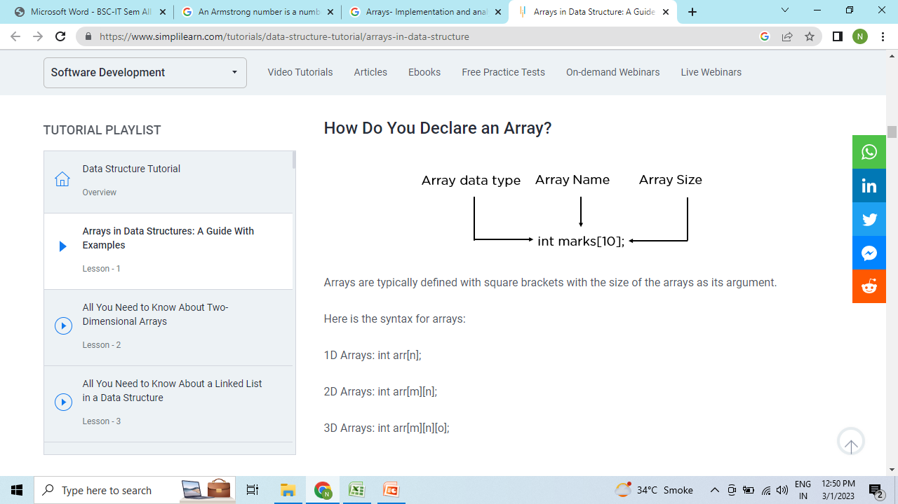
An array is a linear data structure that collects elements of the same data type and stores them in contiguous and adjacent memory locations. Arrays work on an index system starting from 0 to (n-1), where n is the size of the array.

Slide 3
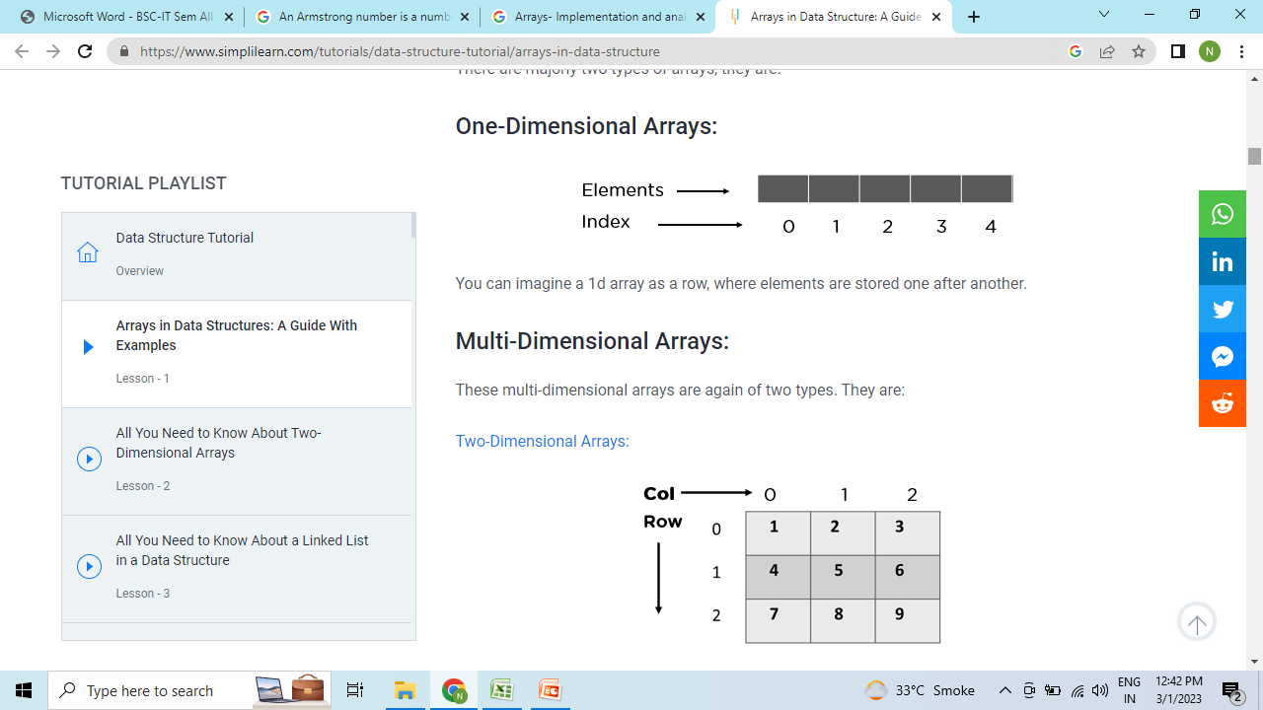
There are majorly two types of arrays, they are:

Slide 4
Basic Operation
Traverse − print all the array elements one by one.
Insertion − Adds an element at the given index.
Deletion − Deletes an element at the given index.
Search − Searches an element using the given index or by the value.
Update − Updates an element at the given index.

Slide 5
Traversal
#include <iostream>
using namespace std;
int main()
{
int arr[5]={10, 0, 20, 0, 30}; //creating and initializing array
//traversing array
for (int i = 0; i < 5; i++)
{
cout<<arr[i]<<"\n";
}
}

Slide 6
Insert element in Array
#include<iostream>
using namespace std;
int main()
{
int arr[6], i, elem;
cout<<"Enter 5 Array Elements: ";
for(i=0; i<5; i++)
cin>>arr[i];
cout<<"\nEnter Element to Insert: ";
cin>>elem;
arr[i] = elem;
cout<<"\nThe New Array is:\n";
for(i=0; i<6; i++)
cout<<arr[i]<<" ";
cout<<endl;
return 0;
}

Slide 7
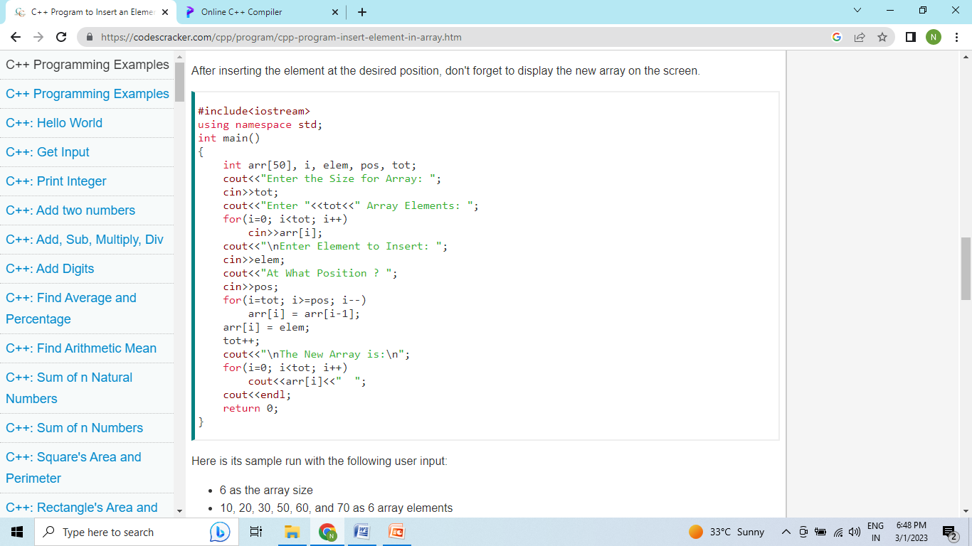
Insert element at position

Slide 8
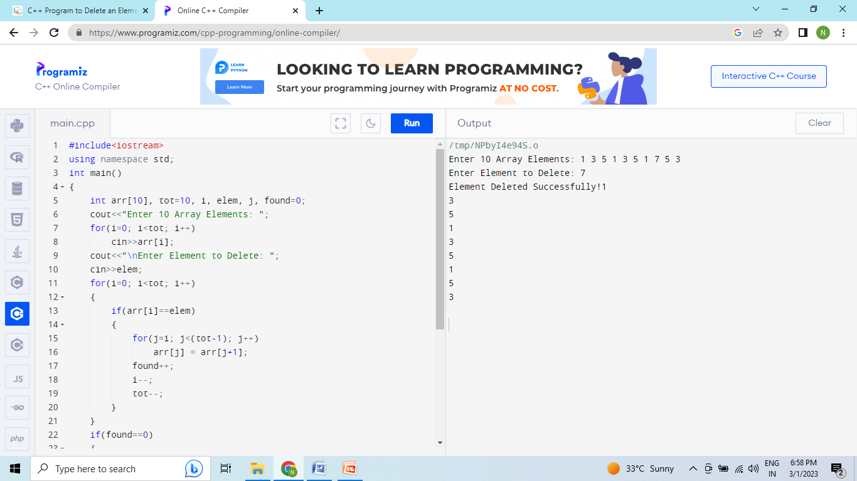
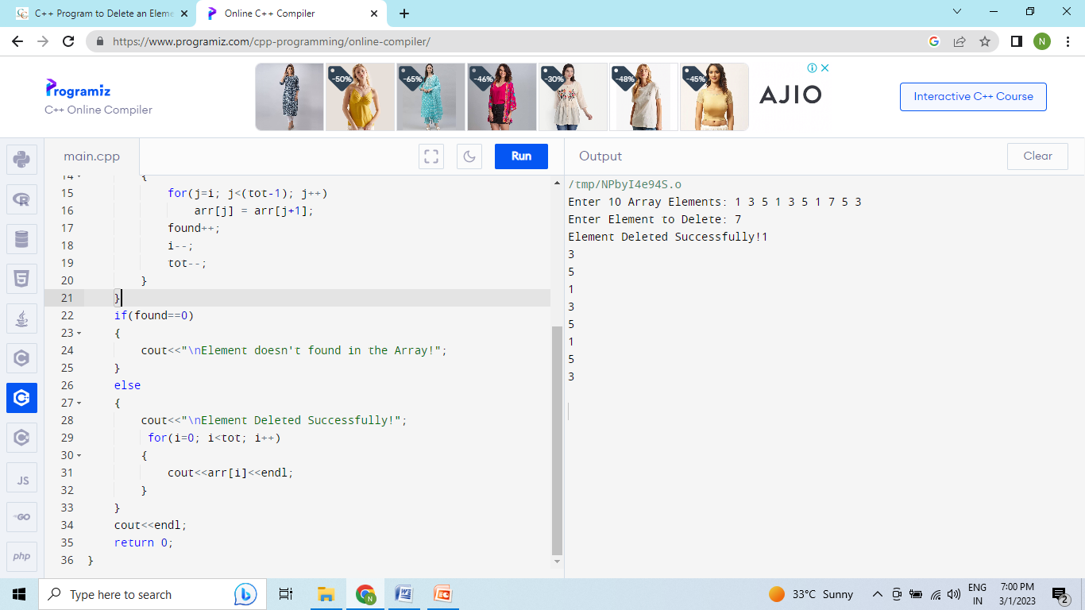
Delete element

Slide 9
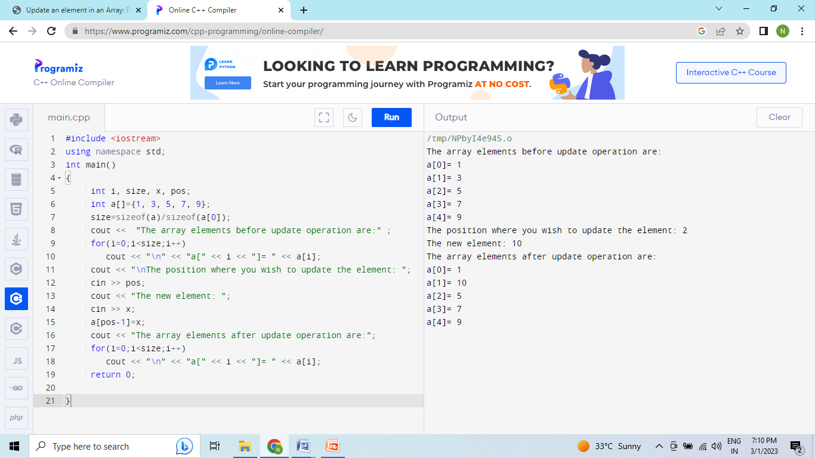
Update Array

Slide 10
Queue
A queue is a logical group of elements in which updates or changes are introduced at one side (the "back") and existing items are deleted at the opposite end (the "front") (the "front"). When an item is introduced to the queue, it moves from the back to the front, ready to be eliminated next. This way of ordering is also known as first-in-first-out (FIFO) (first-in, first-out).

Slide 11
Queue
Used by OS to queue many processes. Eg. While we type, keystrokes might occasionally outweigh the text on the screen. The reason is that the computer is now engaged with other duties. The strokes of keys are queued in a file and eventually shown on the screen in the right sequence.

Slide 12
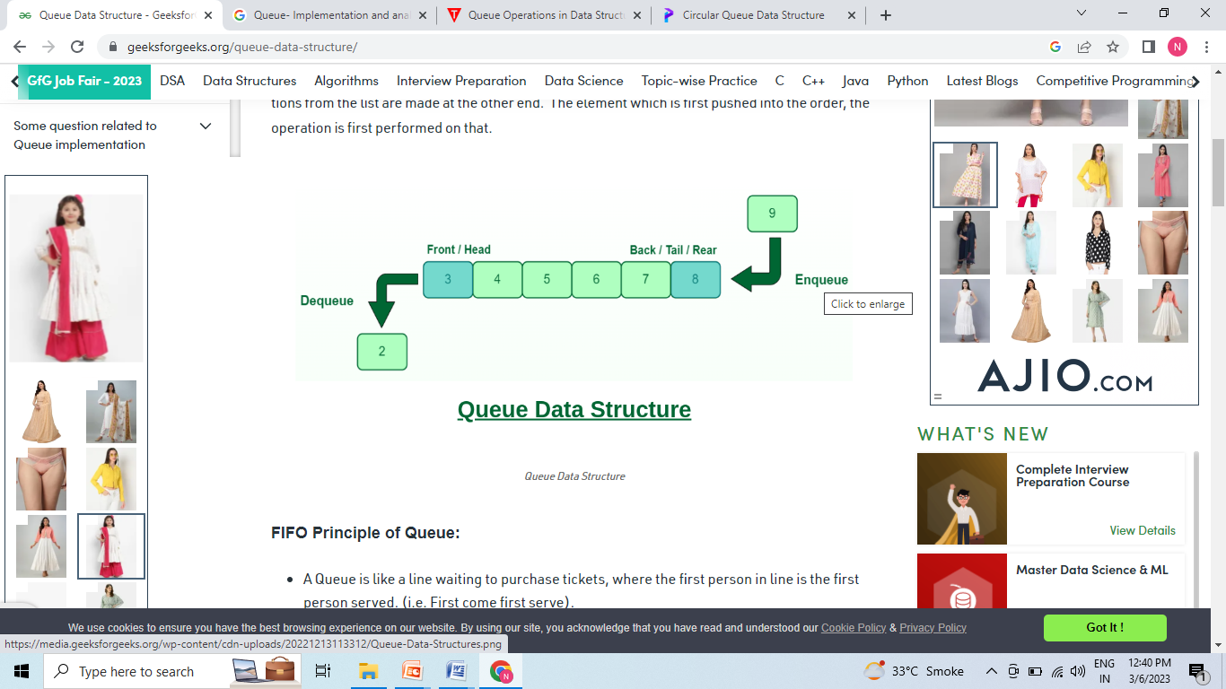

Slide 13
Different operations in Queue Data Structure:
Enqueue operation: The term "enqueue" refers to the act of adding a new element to a queue.
Dequeue operation: Dequeue is the process of deleting an item from a queue.
Front Operation: It returns the value of the first element without deleting it.
isEmpty Operation: The isEmpty() function is used to check if the Queue is empty or not.
isFull Operation: The isFull() function is used to check if the Queue is full or not.

Slide 14
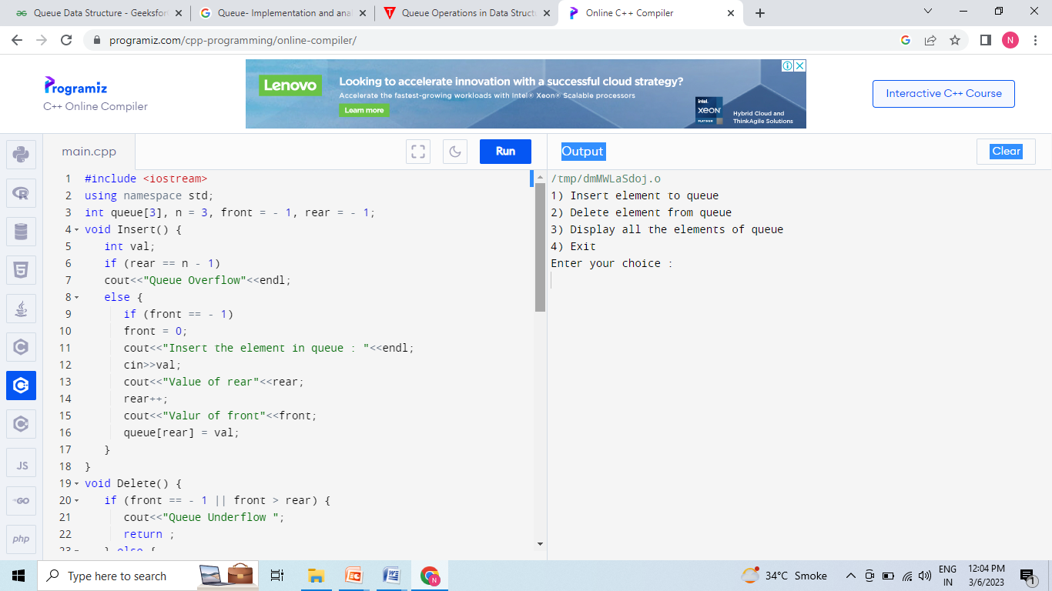

Slide 15
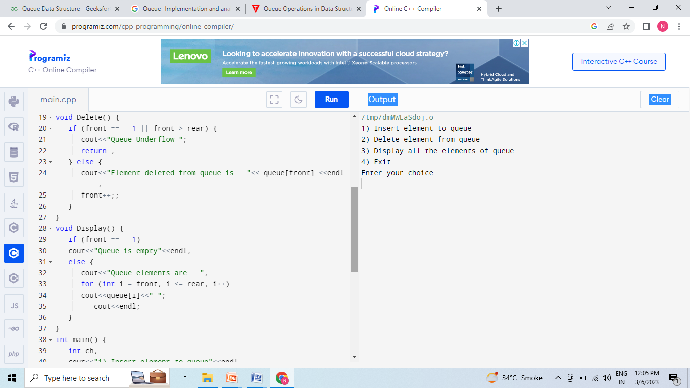

Slide 16
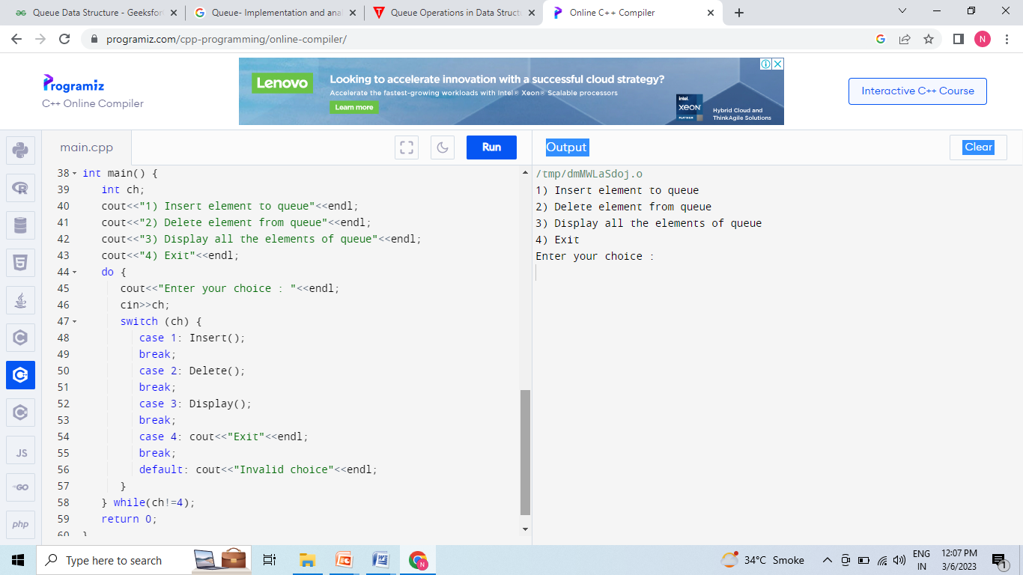

Slide 17
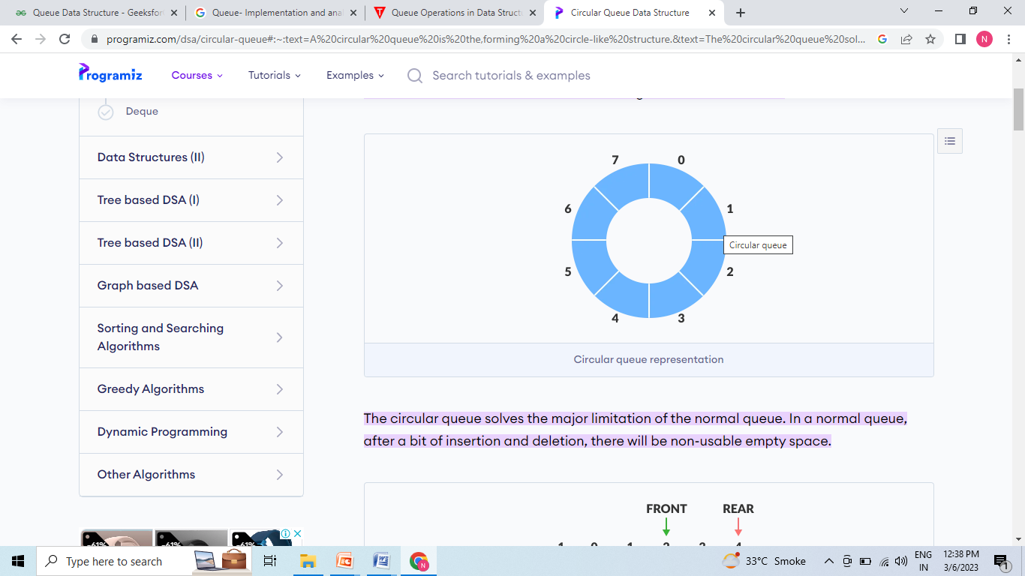
Circular Queue
A circular queue is the extended version of a regular queue where the last element is connected to the first element. Thus forming a circle-like structure.

Slide 18
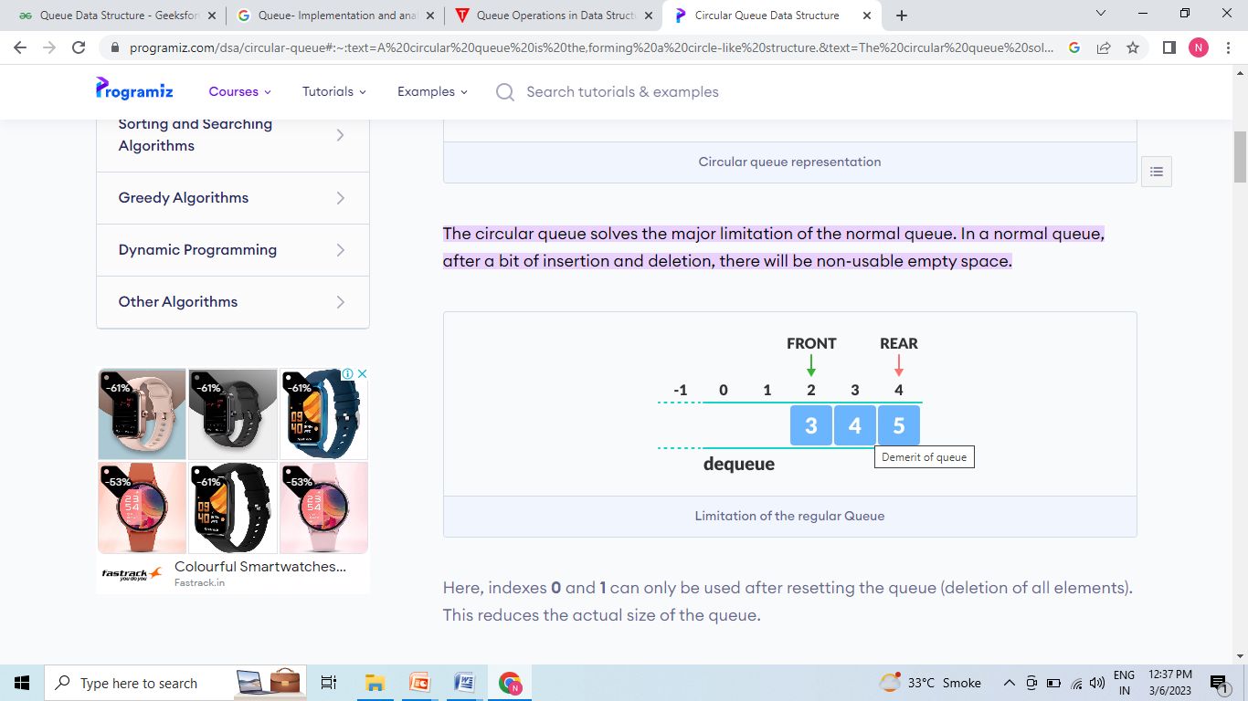

Slide 19
Circular Queue
Circular Queue works by the process of circular increment i.e. when we try to increment the pointer and we reach the end of the queue, we start from the beginning of the queue.
Here, the circular increment is performed by modulo division with the queue size.

Slide 20
Stack
A Stack is a linear data structure that follows the LIFO (Last-In-First-Out) principle. Stack has one end, whereas the Queue has two ends (front and rear). It contains only one pointer top pointer pointing to the topmost element of the stack. Whenever an element is added in the stack, it is added on the top of the stack, and the element can be deleted only from the stack. In other words, a stack can be defined as a container in which insertion and deletion can be done from the one end known as the top of the stack.

Slide 21
Stack
It is called as stack because it behaves like a real-world stack, piles of books, etc.
A Stack is an abstract data type with a pre-defined capacity, which means that it can store the elements of a limited size.

Slide 22
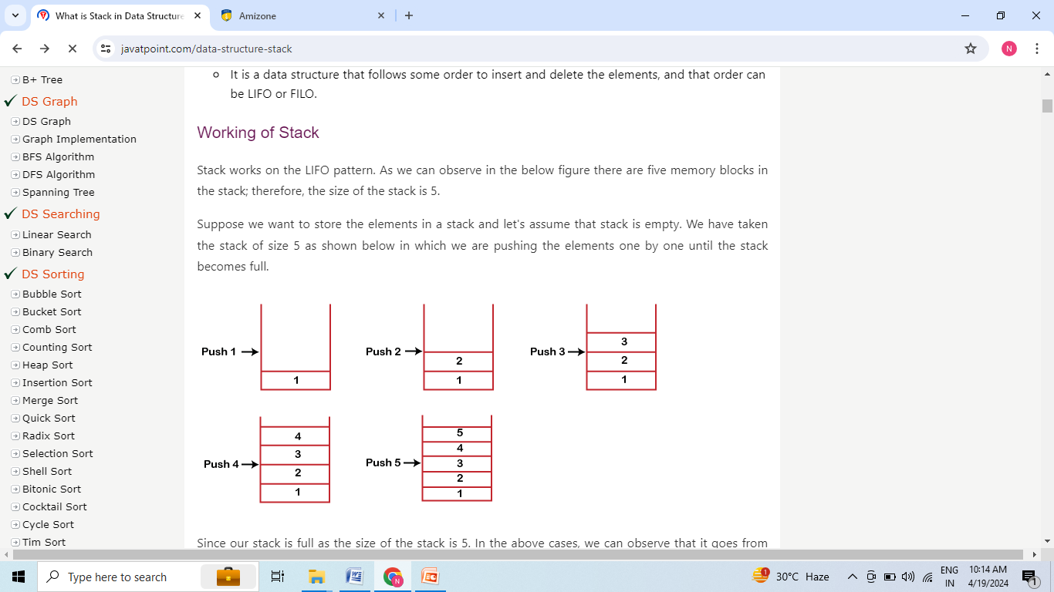
Stack

Slide 23
Stack
When we perform the delete operation on the stack, there is only one way for entry and exit as the other end is closed. It follows the LIFO pattern, which means that the value entered first will be removed last. In the above case, the value 5 is entered first, so it will be removed only after the deletion of all the other elements.

Slide 24
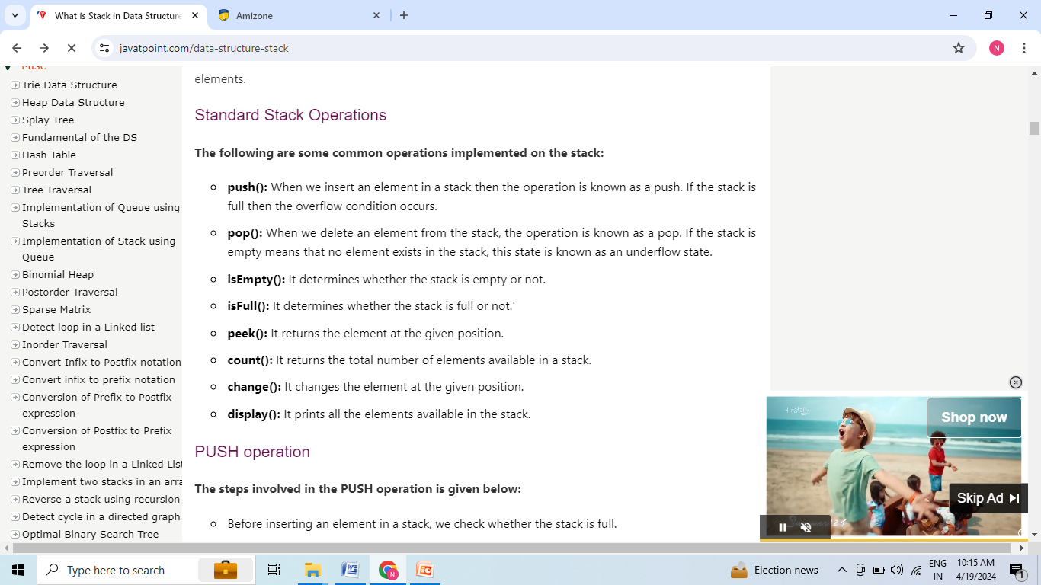
Stack

Slide 25
Stack
The steps involved in the PUSH operation is given below:
Before inserting an element in a stack, we check whether the stack is full.
If we try to insert the element in a stack, and the stack is full, then the overflow condition occurs.
When we initialize a stack, we set the value of top as -1 to check that the stack is empty.
When the new element is pushed in a stack, first, the value of the top gets incremented, i.e., top=top+1, and the element will be placed at the new position of the top.
The elements will be inserted until we reach the max size of the stack.

Slide 26
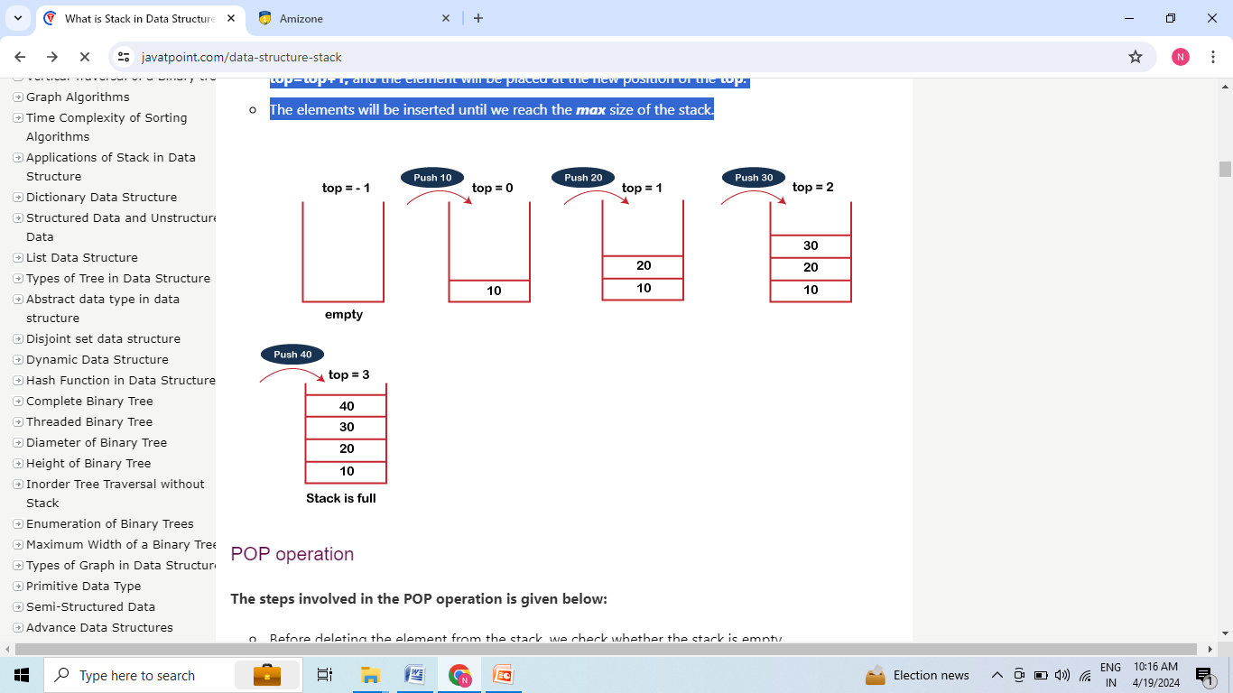
Stack

Slide 27
Stack
The steps involved in the POP operation is given below:
Before deleting the element from the stack, we check whether the stack is empty.
If we try to delete the element from the empty stack, then the underflow condition occurs.
If the stack is not empty, we first access the element which is pointed by the top
Once the pop operation is performed, the top is decremented by 1, i.e., top=top-1.

Slide 28
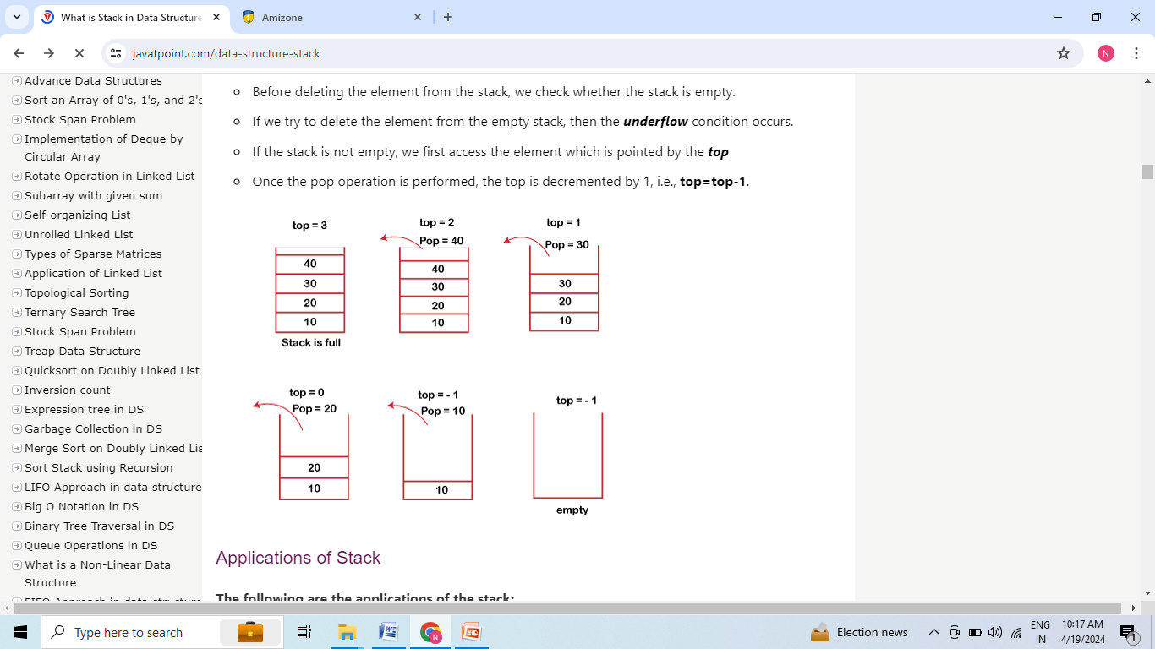
Stack

